Slide 1

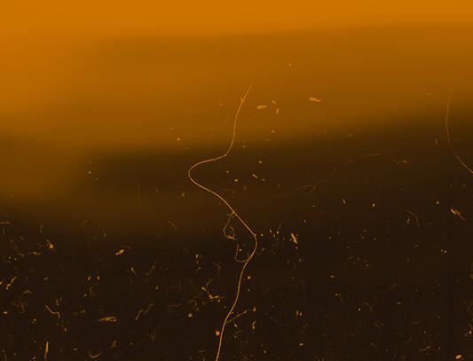
TEAM ANANT
ORIENTATION
ANTLIA
1998
ORION
1998

Slide 2

01.
Intro to Team Anant

Slide 3
02.
Systems Overview

Slide 4
03.
Attitude Determination and Control Systems

Slide 5
CubeSat :)

Slide 6
CubeSat :)

Slide 7



CubeSat :)

Slide 8



ATTITUDE DETERMINATION HARDWARE
MAGNETIC FIELD SENSOR
SUN SENSOR
STAR SENSOR

Slide 9
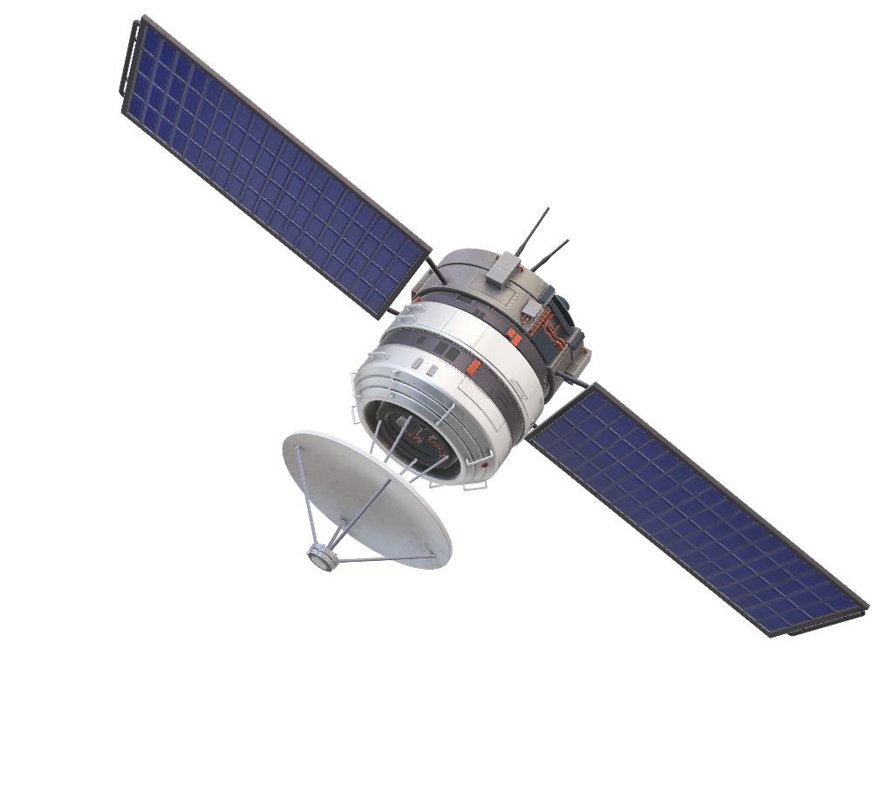
The Need for Estimation

Slide 10
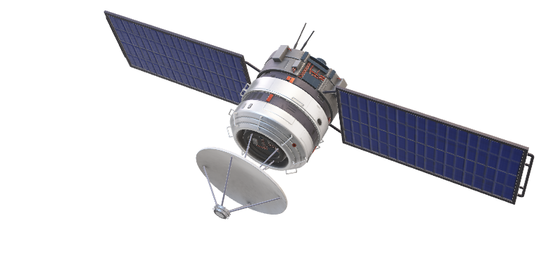

Slide 11
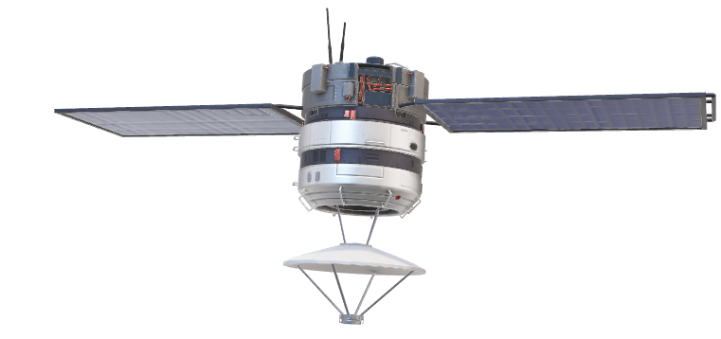

Slide 12
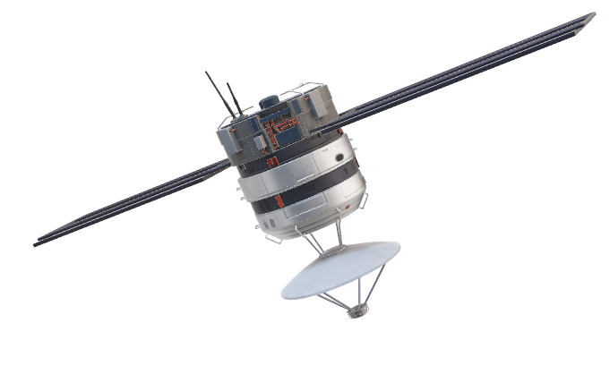

Slide 13
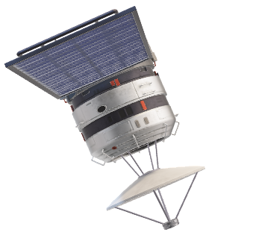

Slide 14


ESTIMATIONS
DATA PREDICTION
DATA FILTERING

Slide 15
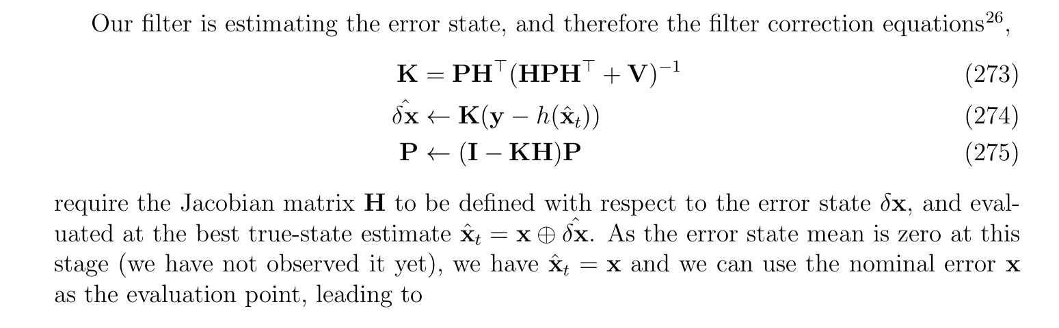

Slide 16
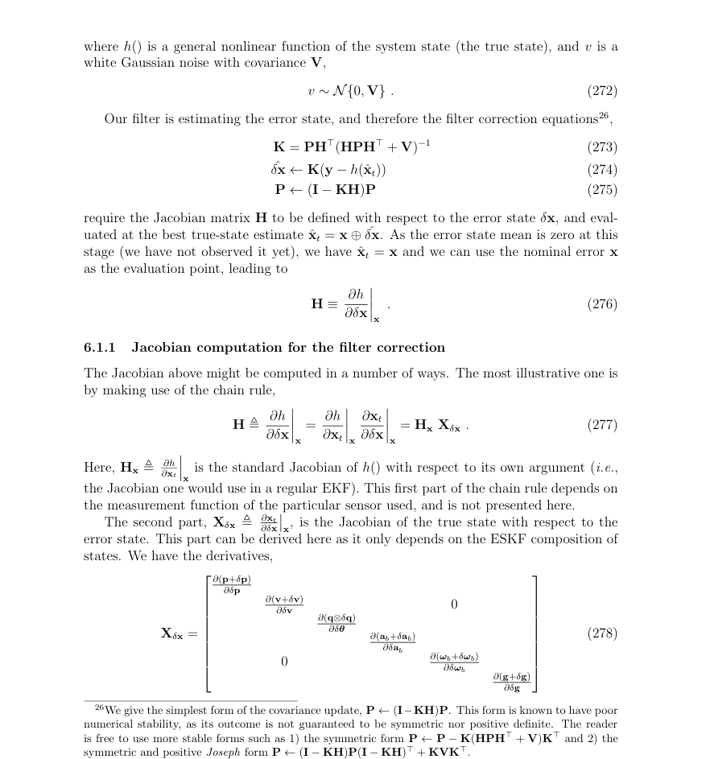
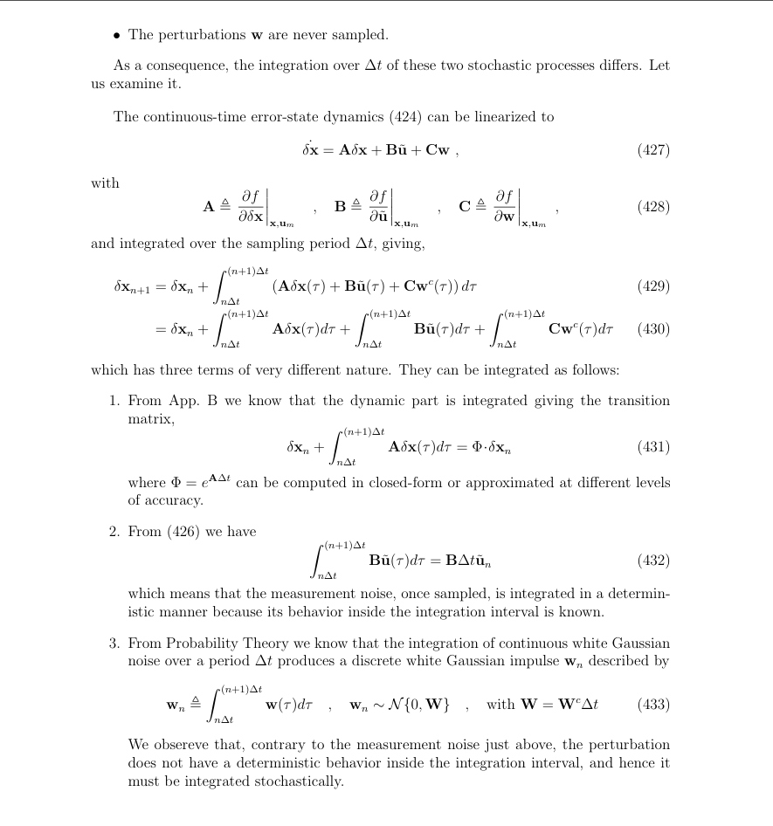

Slide 17
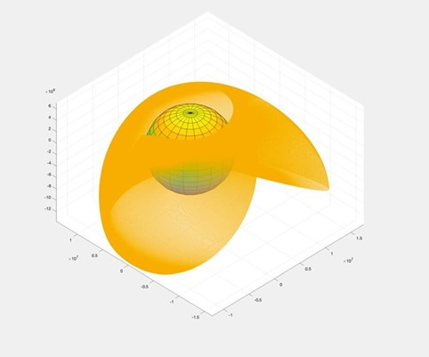
NAVIGATION
ORBIT PROPAGATION
ORBITAL MODES

Slide 18
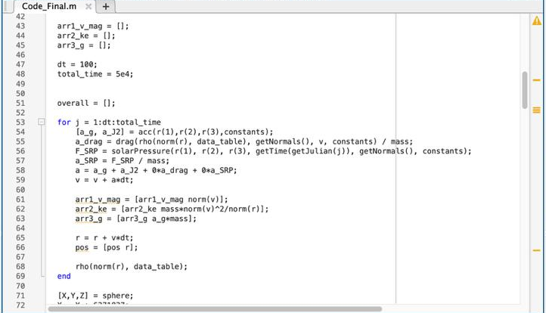

Slide 19
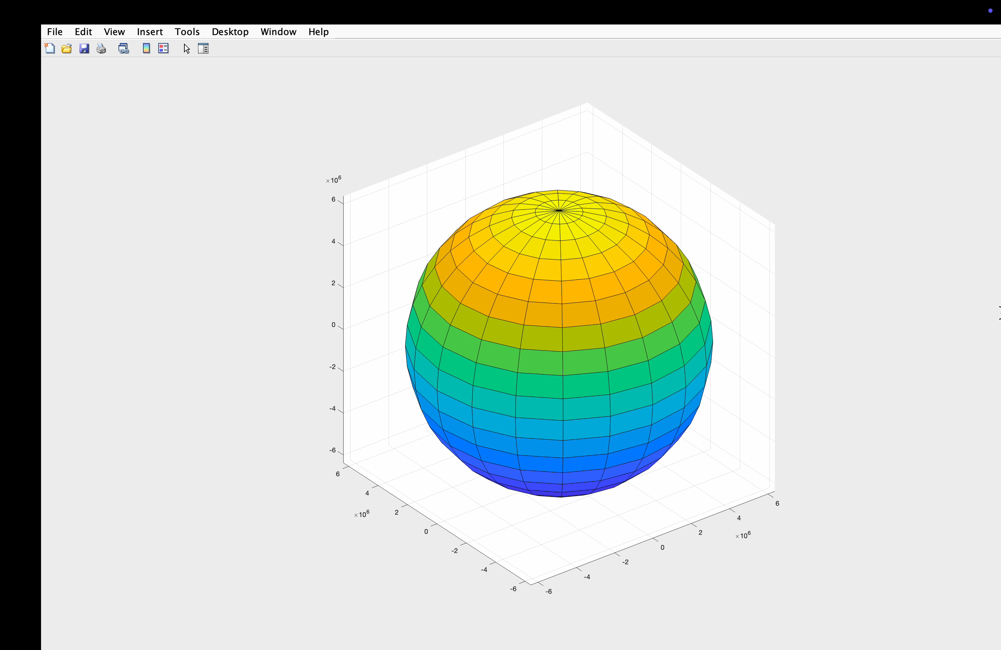

Slide 20
CONTROL SYSTEMS
REACTION WHEELS
MAGNETOTORQUERS

Slide 21
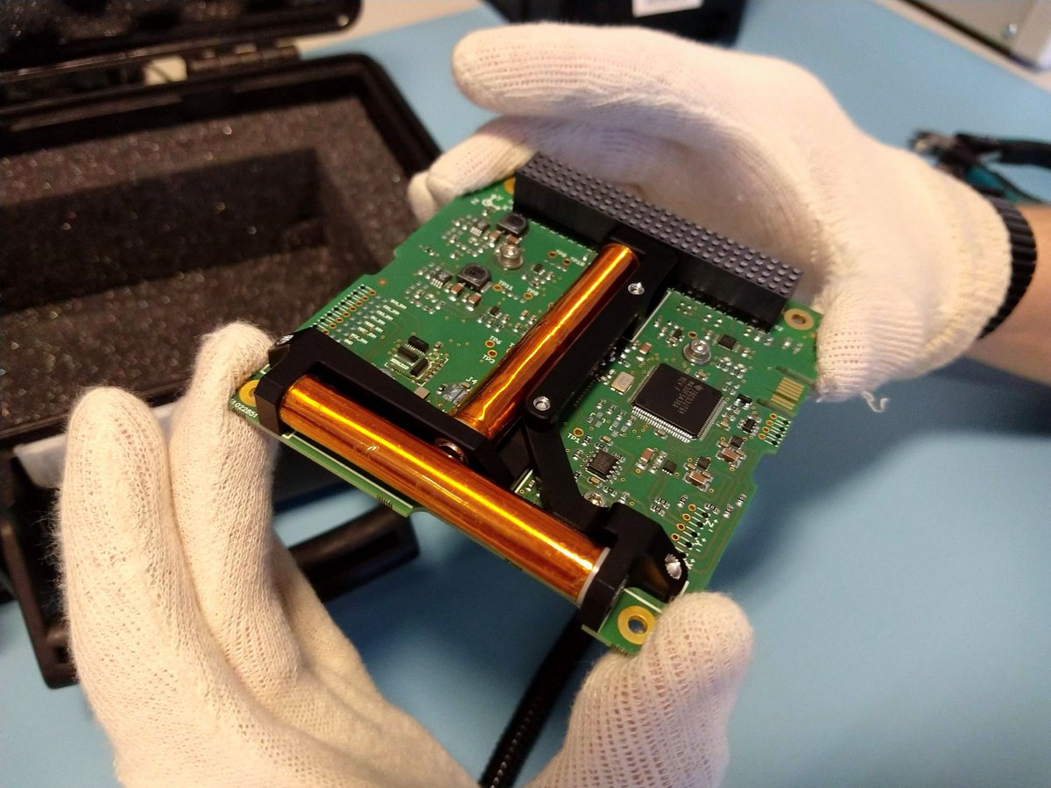
MAGNETORQUERS

Slide 22
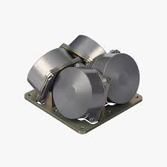
REACTION WHEELS

Slide 23
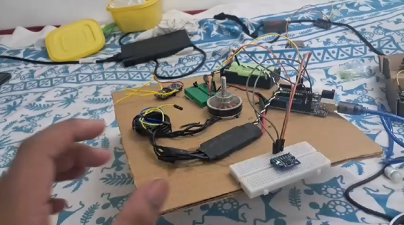
REACTION WHEELS

Slide 24
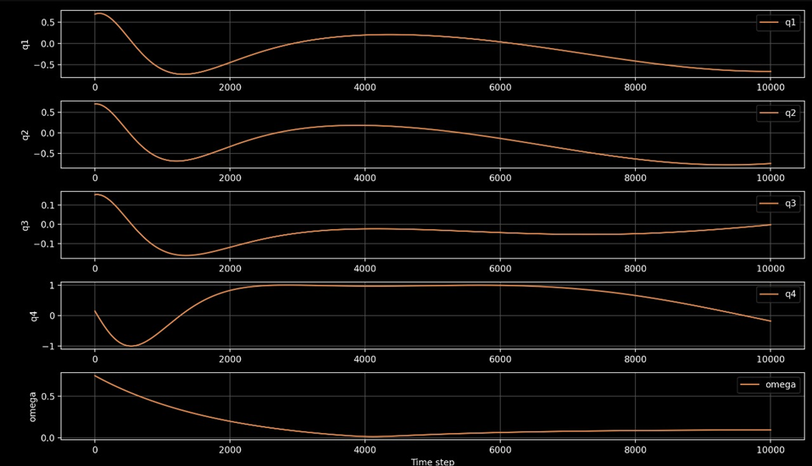
CONTROL

Slide 25
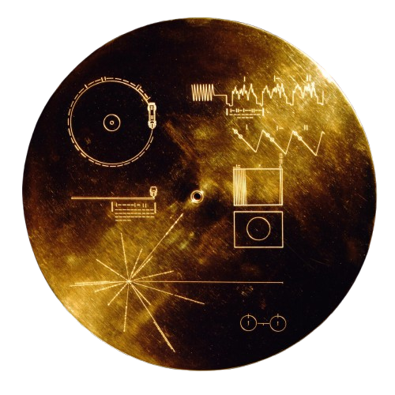

04.
TELEMETRY, TRACKING AND COMMAND
T
1

Slide 26
Telemetry Tracking & Command: WWWHAAATTT??!!!
T
Telemetry: Downlinking of Data from the satellite to the ground station.
T
C

Slide 27
Telemetry Tracking & Command: WWWHAAATTT??!!!
T
Tracking: Locating the position of the satellite in the orbit to ensure that the ground station antennas stay pointed towards the satellite.
T
C

Slide 28
Telemetry Tracking & Command: WWWHAAATTT??!!!
T
Command: Uplink data/instructions from the ground station to the satellite.
T
C

Slide 29
Forms of Data that we deal with:
T
Primary Data: The image. This is downlinked from the satellite to the ground station.
T
C

Slide 30
Forms of Data that we deal with:
T
Beacon: This signal is tracked, to locate the satellite in orbit and to ensure that the satellite is alive. Also provides basic housekeeping data about the satellite.
T
C

Slide 31
Forms of Data that we deal with:
T
Commands: These instructions are uplinked from the ground station to the satellite.
T
C

Slide 32
Software Defined Radios
T
T
C
Communication system that uses software for digital signal processing.

Slide 33
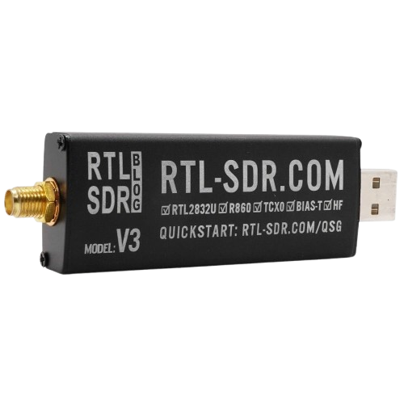
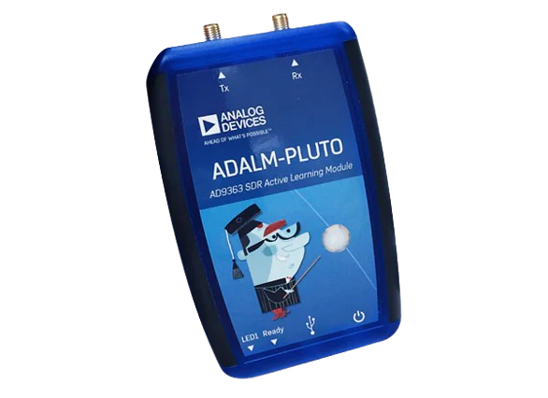
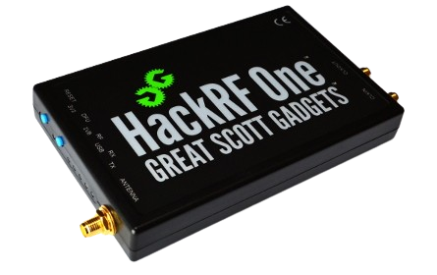
T
T
C
Communication system that uses software for digital signal processing.

Slide 34
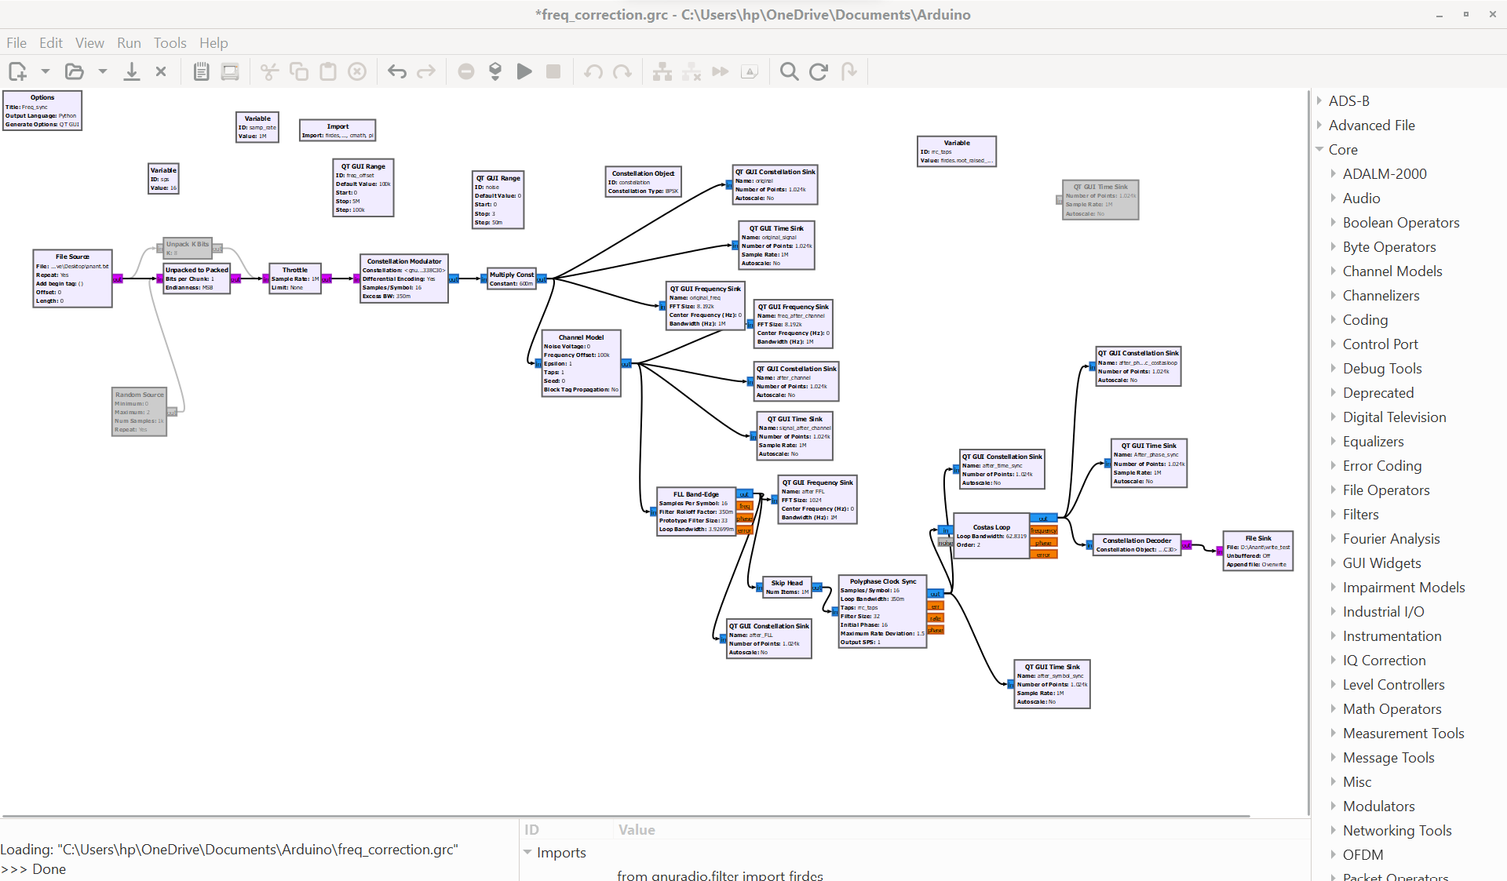
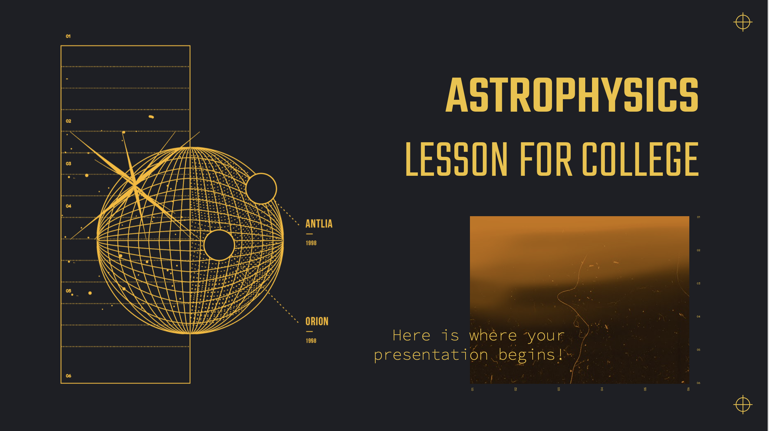
OK, but how do I use the SDR?
T
GNU Radio Companion is a visual tool for designing and simulating software-defined radios and signal processing systems using flowgraphs.
T
C

Slide 35
OK, but how do I use the SDR?
T
GNU Radio Companion is a visual tool for designing and simulating software-defined radios and signal processing systems using flowgraphs.
2

Slide 36
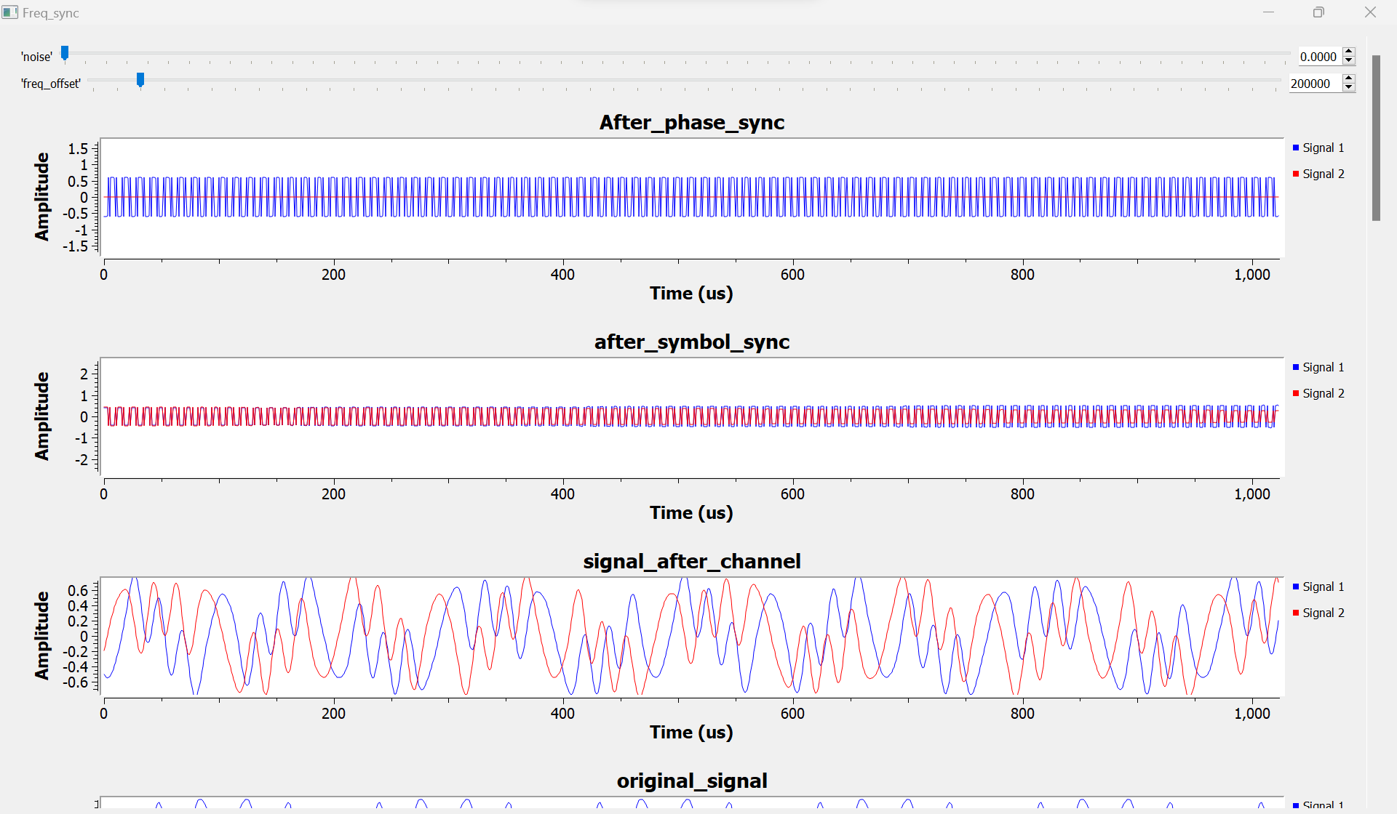
180,506,000
T
1
Light years away is located is the Westerlund star cluster from Earth, in the southern constellation of Ara

Slide 37
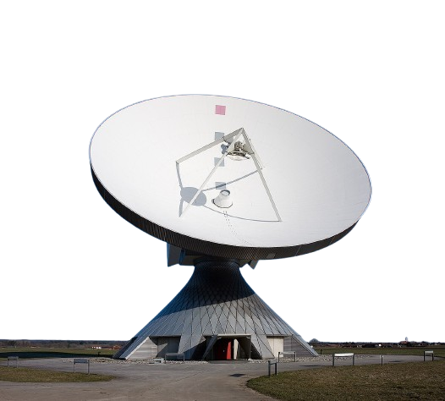
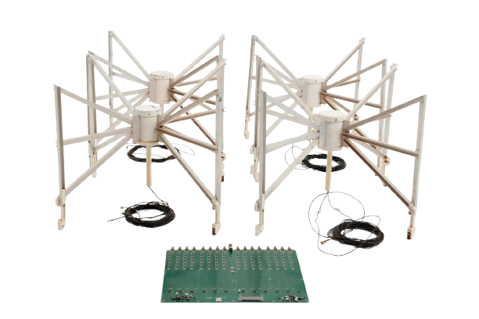
Antennas?!
A little (sometimes large) metal thingy that sends EM waves to a far away place.
T
T
C

Slide 38
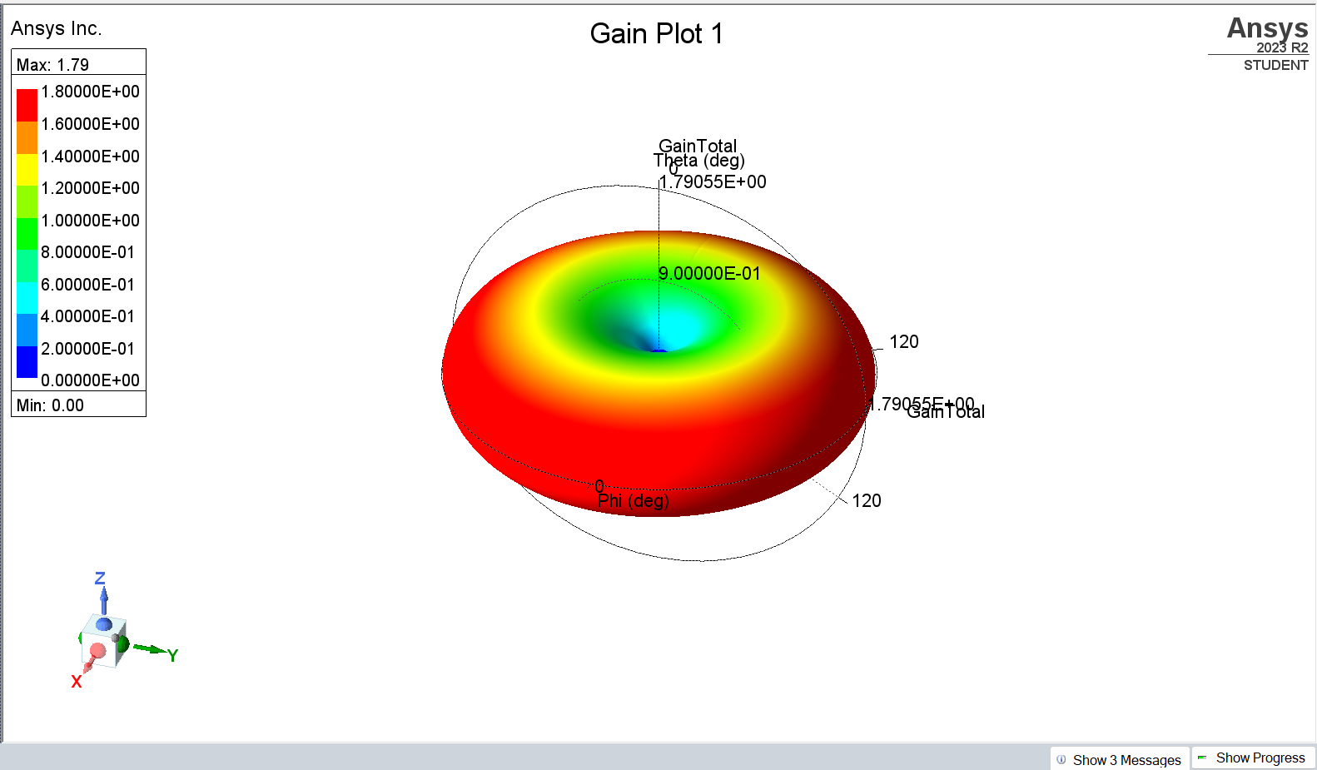
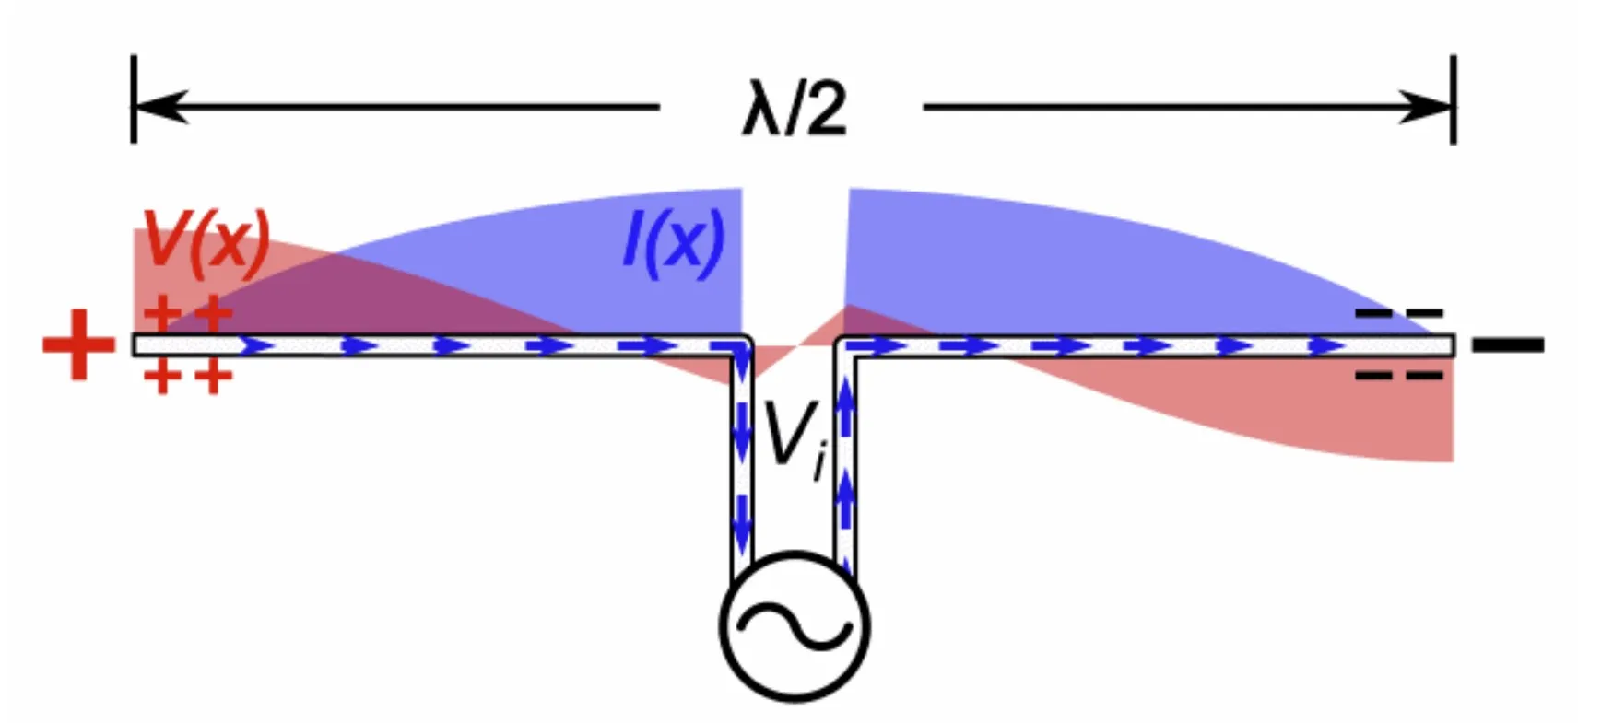
180,506,000
T
1
Light years away is located is the Westerlund star cluster from Earth, in the southern constellation of Ara
SIMULATED GAIN PLOT FOR A DIPOLE ANTENNA OPERATING AT 2.4 GHz

Slide 39
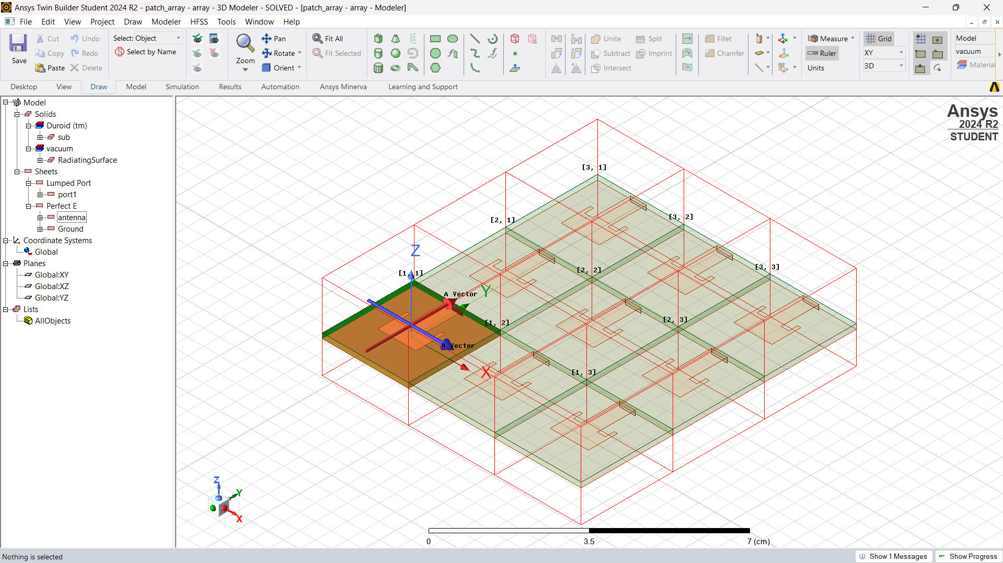
180,506,000
T
1
Light years away is located is the Westerlund star cluster from Earth, in the southern constellation of Ara
SIMULATED GAIN PLOT FOR A DIPOLE ANTENNA OPERATING AT 2.4 GHz
SIMULATION FOR A 3x3 PATCH ANTENNA ARRAY OPERATING AT 10 GHz

Slide 40
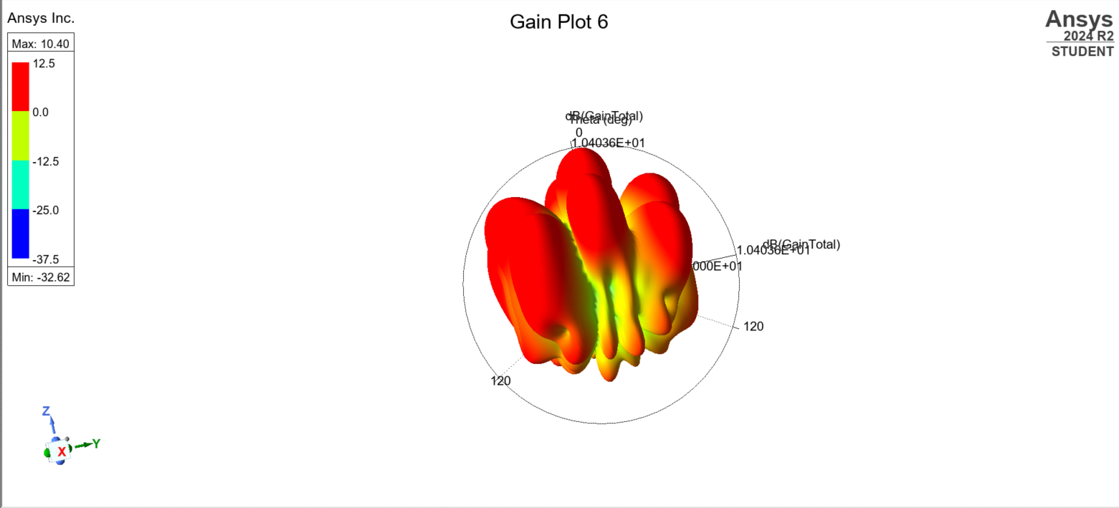
180,506,000
T
1
Light years away is located is the Westerlund star cluster from Earth, in the southern constellation of Ara
SIMULATED GAIN PLOT FOR A DIPOLE ANTENNA OPERATING AT 2.4 GHz
IT'S GAIN PLOT

Slide 41
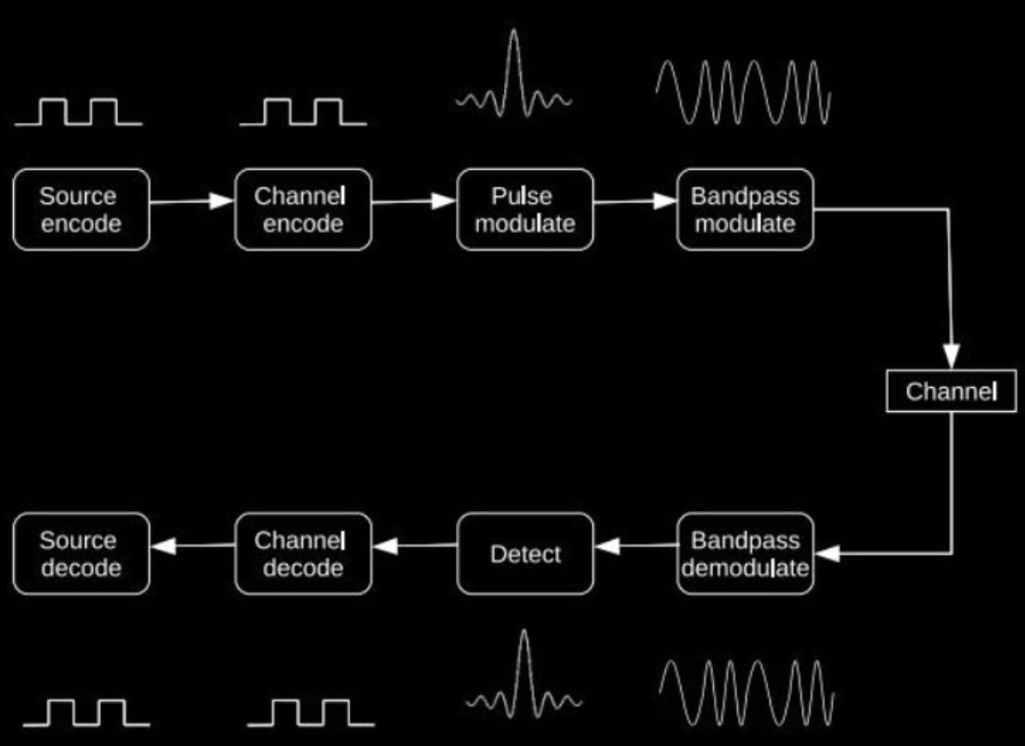
Telemetry Tracking & Command: Digital Communication
T
T
C

Slide 42
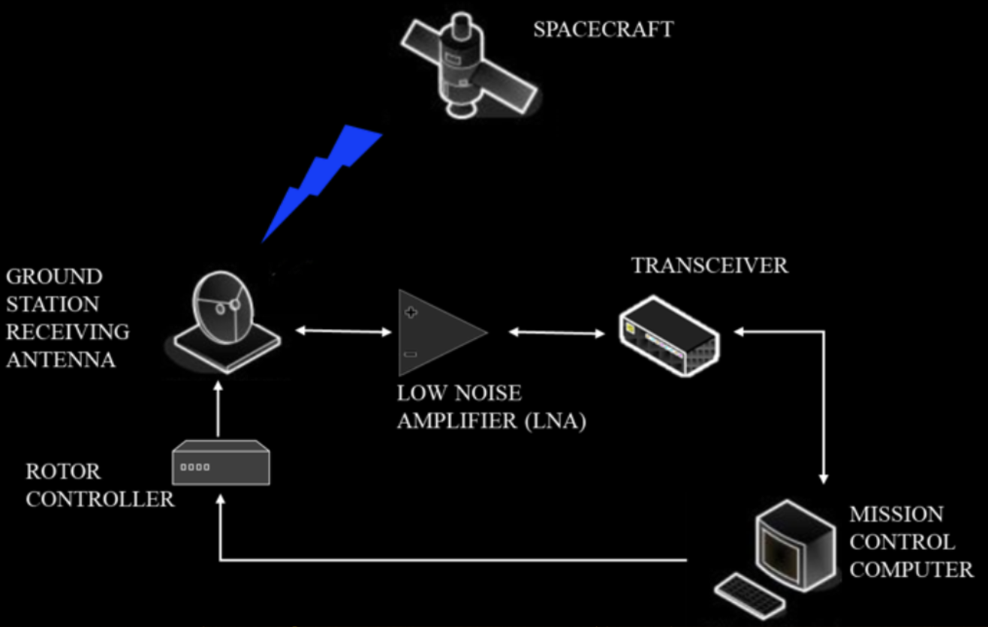
Telemetry Tracking & Command: Ground Station
T
T
C

Slide 43
05.
STRUCTURAL AND THERMAL SUBSYSTEM

Slide 44
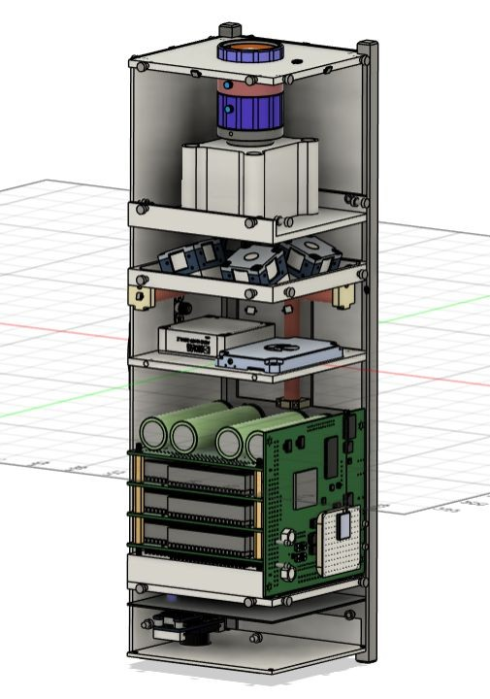
STRUCTURE
As part of the structure we need to design something that will survive launch loads, while providing an easily accessible data and power bus for debugging and assembly of components.

Slide 45
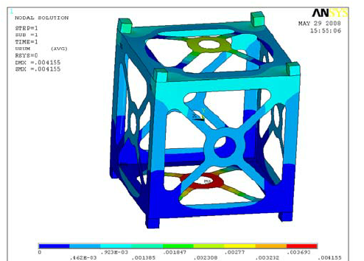
STRUCTURAL ANALYSIS
Static Loads
Quasi Static Loads
Sinusoidal Vibrations
Random Vibrations

Slide 46
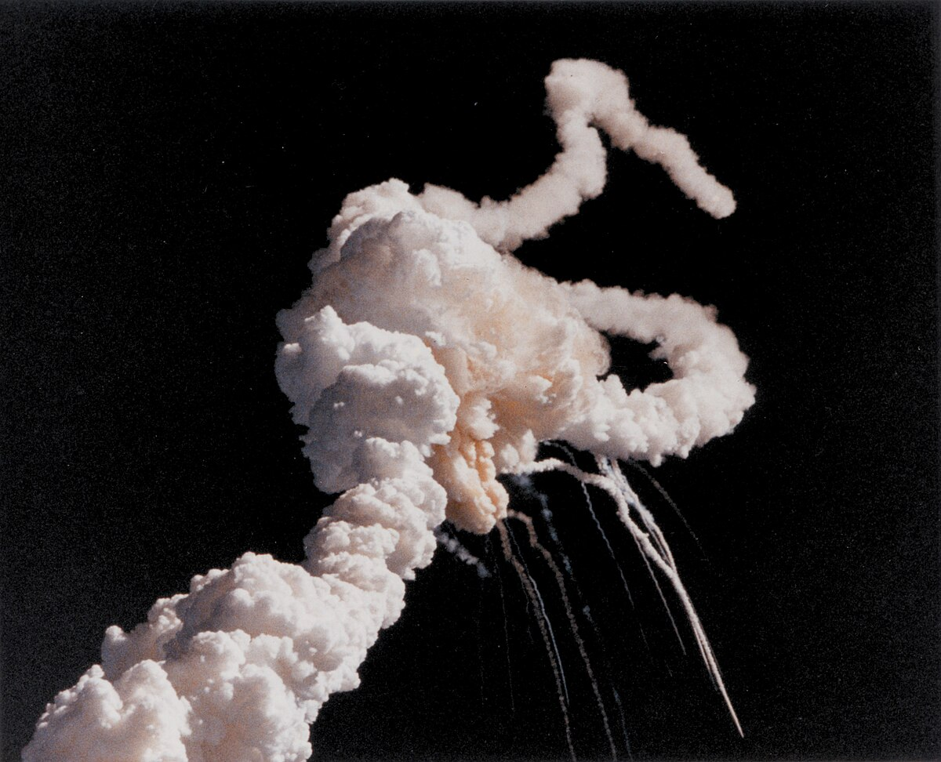
IMPORTANCE OF THERMAL ANALYSIS

Slide 47
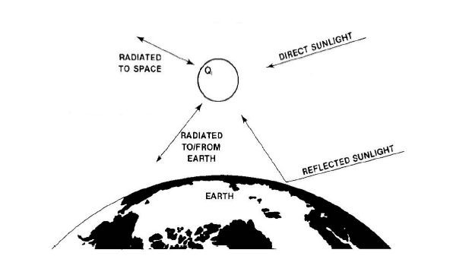
IMPORTANCE OF THERMAL ANALYSIS

Slide 48
SIGNIFICANCE OF THERMAL ANALYSIS
Maintaining the temperatures for each component of the satellite is important for the safety of the components.
Orbital parameters like different angle values, vectors and values like Ltan (local time at ascending node), influence the thermal loads that the CubeSAT experiences.
Component | Operating Temperature (degrees Celsius)
Batteries | 10 to 45
Solar Panels | -25 to 50
Geomagnetic Sensors | -40 to 85
PCBs | -40 to 85

Slide 49
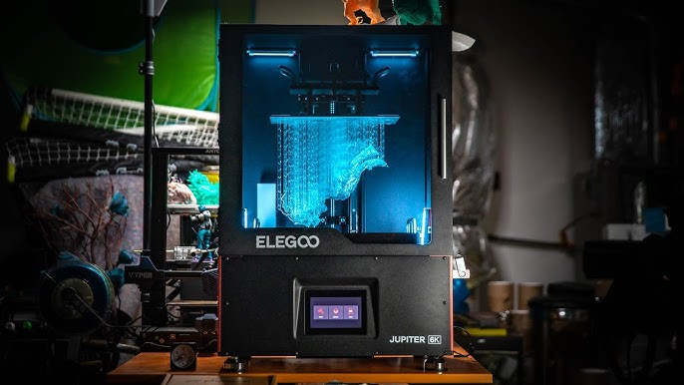
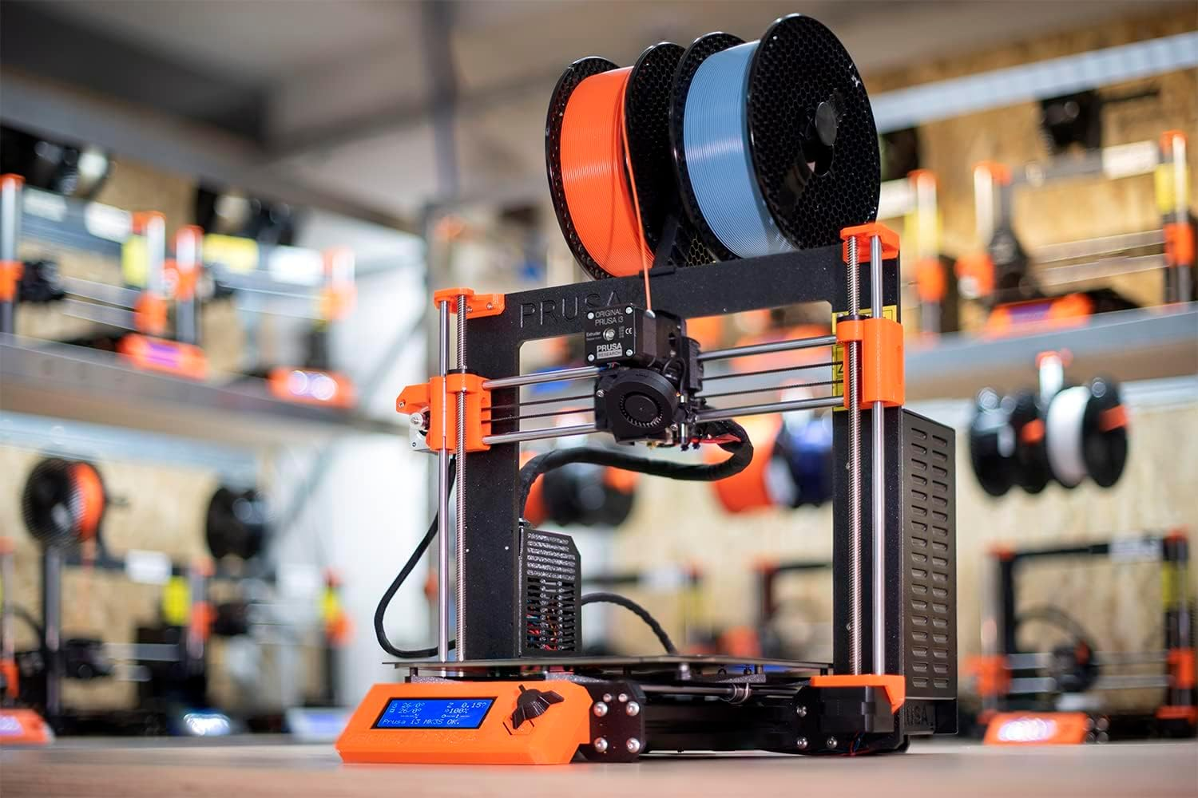
MANUFACTURING
In STS Manufacturing is the ultimate constraint to a design.
You can have the most magnificent design but if it can’t be made it isn’t as useful as it can be.
We use both additive manufacturing as well as classical methods of manufacturing to make our prototypes for subsystems to use.

Slide 50
06.
PAYLOAD
T
1

Slide 51
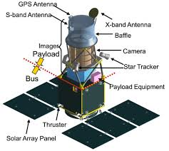
PAYLOAD
A scientific or technological instrument on a satellite that's designed to achieve the satellite's mission

Slide 52
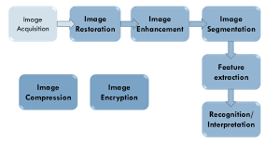
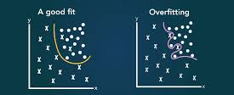

SKILLS REQUIRED
MACHINE LEARNING & DEEP LEARNING
IMAGE PROCESSING
WILL TO LEARN!!!

Slide 53

07.
ELECTRICAL POWER SYSTEM
T
1

Slide 54
ABOUT EPS
The Electrical & Power Subsystem (EPS) is one of the essential subsystems for the CubeSat since it handles power generation, energy storage, and power distribution to all other subsystems.
Therefore, the design of EPS becomes crucial for successful CubeSat mission, wherein the first step is the selection of EPS architecture.
DEVELOPMENT of advanced electronics have enabled
building of CubeSats with powerful capabilities that were
previously dominated by larger satellites.

Slide 55

CORE FUNCTIONS OF EPS
Generate
Store
Distribute
Regulate
POWER SOURCE
ENERGY STORAGE
POWER DISTRIBUTION
POWER REGULATION AND CONTROL

Slide 56
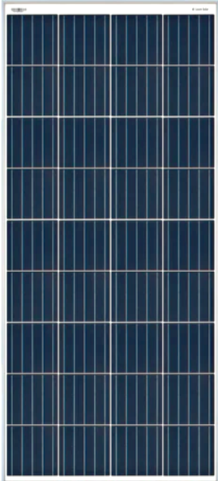
Basic Components of CubeSAT EPS
Power Conversion
Power Distribution
LOADS
LOADS
LOADS
Energy Storage

Slide 57

POWER STORAGE
Why do we need Power Storage ?

Slide 58
As the CubeSat revolves in an orbit, it experiences both sunlit and eclipse periods.
In Sunlit Period, the CubeSat is illuminated by sunlight and the angle of incidence of sunlight on the photovoltaic (PV) arrays varies from 66.55 to 90 degrees.
During Eclipse Period, the Earth blocks the sunlight from illuminating the CubeSat once in every orbit in all seasons and the temperature drops sharply. The eclipse period is dependent on the orbit altitude, inclination, and the sunlight incidence angle on the orbit plane.

Slide 59
The storage system is required during eclipse period and peak load conditions.
The energy storage system consists of lithium-ion (Li-ion) cells due to higher energy density, higher number of charge/discharge cycles, and lower self-discharge rate.
On the other hand, the Li-ion batteries have following disadvantages:
(1) the life-cycle of Li-ion battery degrades due to higher charge/discharge rates [23]
(2) Li-ion battery has limited energy density at lower temperatures (<−20oC)
(3) Charge rate of Li-ion battery is very low at lower temperatures with the possibility of life reduction.

Slide 60
Printed Circuit Boards
Power Distribution

Slide 61
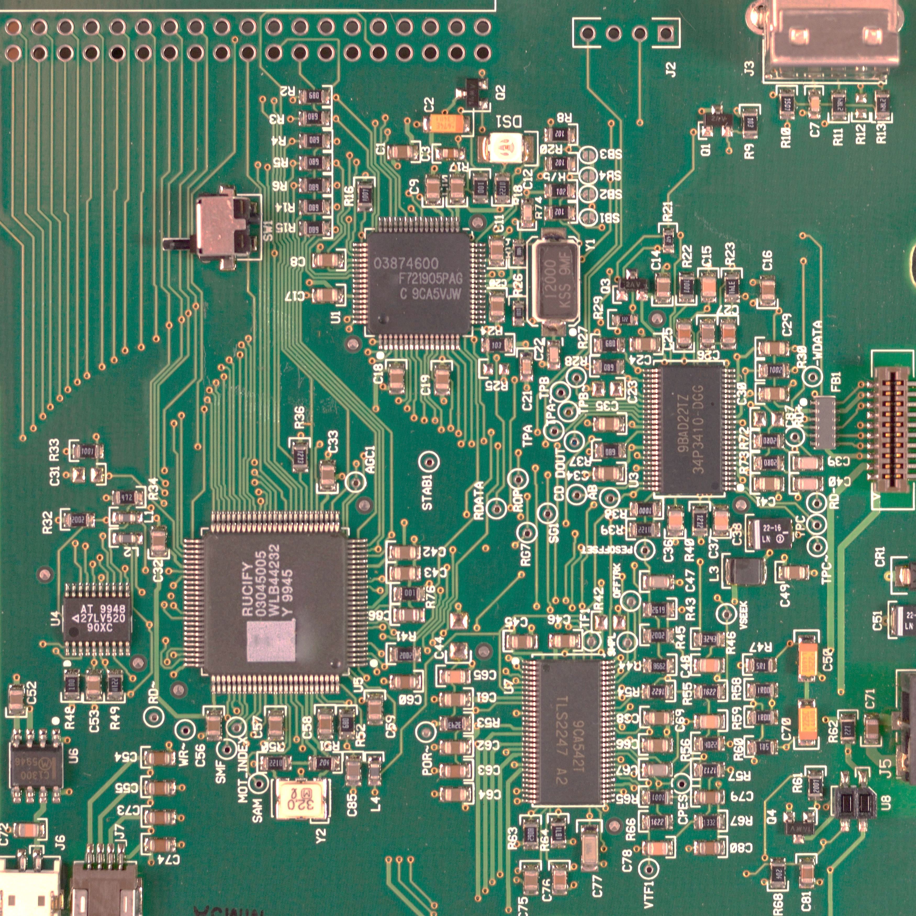
Traces
PCB

Slide 62
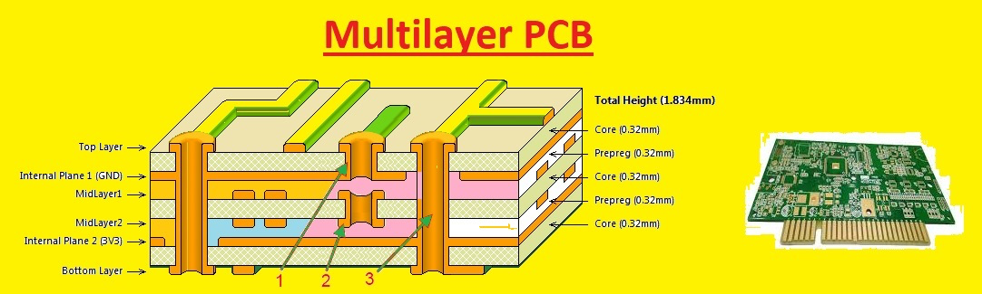
A Printed circuit board (PCB) is an electronic assembly that uses copper conductors to create electrical connections between components.
Printed circuit boards provide mechanical support for electronic components so that a device can be mounted in an enclosure. A printed circuit board design must include a specific set of steps that aligns with the manufacturing process, integrated circuit packaging, and the structure of the bare circuit board.

Slide 63

EPS Microcontroller
MSP430F5529

Slide 64
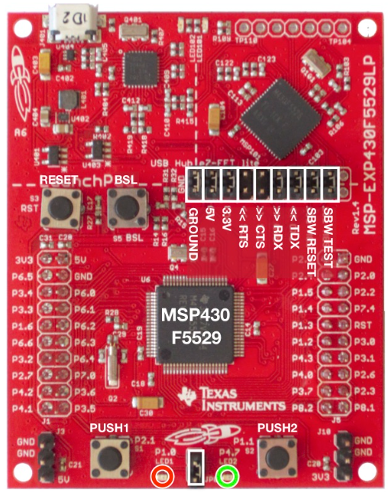
The MSP has a storage capacity of only 128 kilobytes and consists all of the software of the EPS subsystem.
The software used in the satellite is variation of the commonly used language ‘C’ and it’s called ‘embedded C’.
MSP430F5529

Slide 65
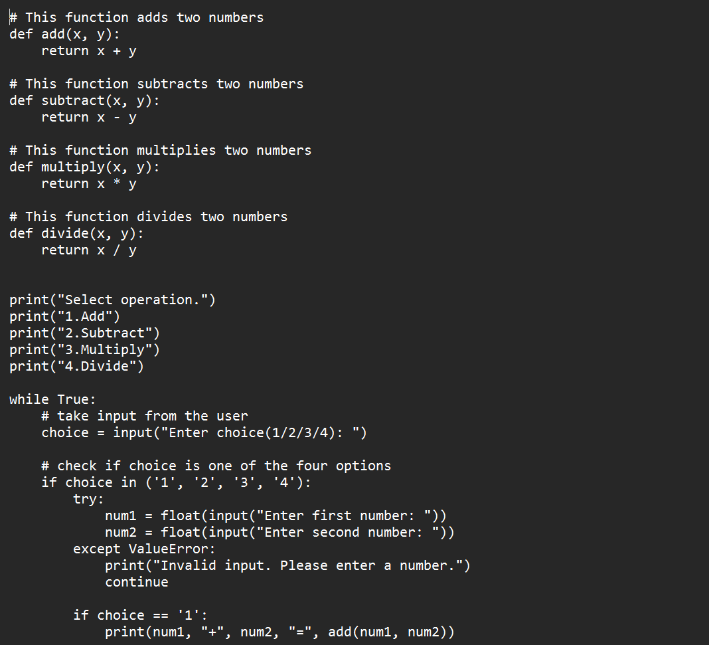
A Simple Python Calculator is 3 KB

Slide 66
08.
ON BOARD COMPUTING

Slide 67
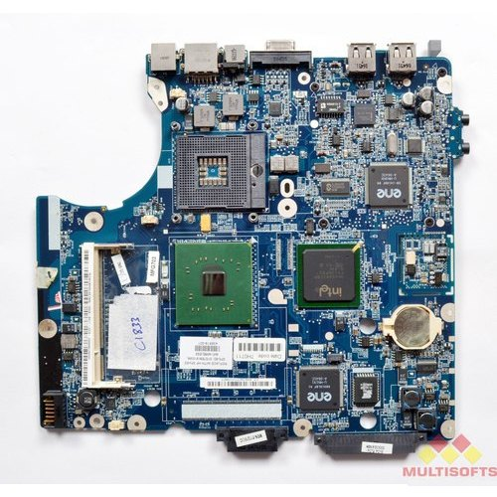
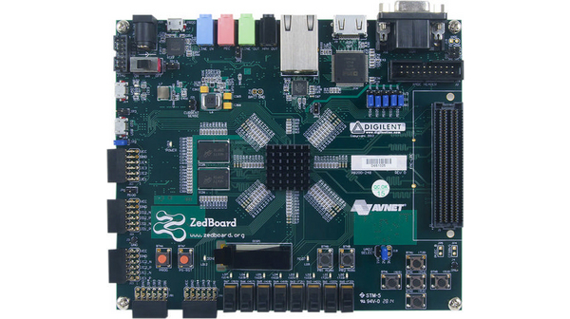
MOTHERBOARD OF LAPTOP
MOTHERBOARD OF CUBESAT

Slide 68
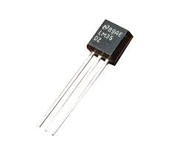
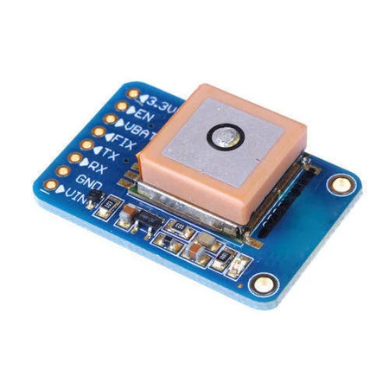
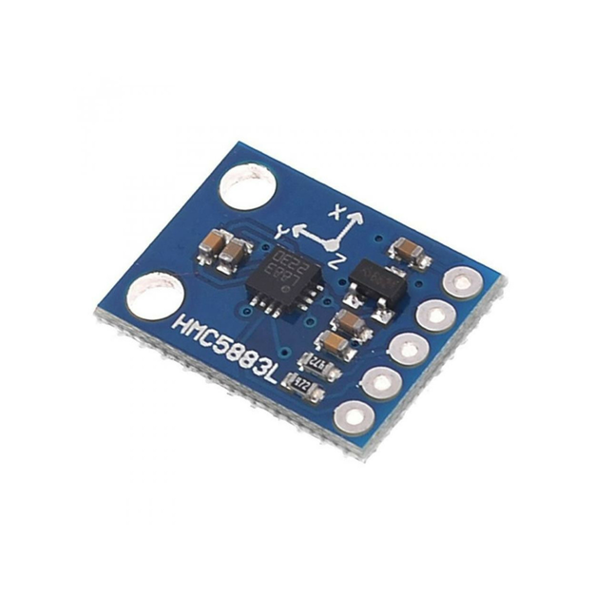

SENSOR INTERFACING

Slide 69


COMMUNICATION PROTOCOLS

Slide 70

OPERATING SYSTEM - LINUX
T
1

Slide 71

FLIGHT PLAN

Slide 72

SO BASICALLY, WE
INTERFACE SENSORS
CODE FLIGHT PLAN
BUILD OS

Slide 73
09.
PUBLICITY SPONSORSHIP AND DESIGN

Slide 74
VERTICALS
01
02
WEB DEVELOPMENT
UI/UX & GRAPHIC DESIGNING

Slide 75
UI/UX & GRAPHIC DESIGNING
The UI/UX & Graphic Designing Vertical of Team Anant is dedicated to creating visually stunning and user-centric experiences. We are a team of creative minds who blend art and technology to design intuitive interfaces and captivating visuals.
We work on maintaining Team Anant’s online presence by creating engaging posts as you all might have seen through our official handles on LinkedIn and Instagram. We also design Team Anant’s merch.
Joining the team will equip you with skills like Figma and Adobe Photoshop. Have a happy learning experience!

Slide 76
WEB-DEVELOPMENT
The Web Development Vertical of Team Anant is at the forefront of crafting the online presence of the team. We are a passionate group of developers who translate creative ideas into stunning, user-friendly websites. We are responsible for the development, and ongoing maintenance of the Team Anant's online platform. We’re currently working on revamping the website. This will provide you with a great opportunity to learn frameworks such as React as well as HTML, CSS and JavaScript.

Slide 77
RECRUITMENT PROCESS
PHASE 1
24 HOUR TEST
PHASE 2
INTERVIEWS
PHASE 3
PROBATION LECTURES
PHASE 4
PROBATION INTERVIEWS
A 24 hour long, open internet, open ChatGPT test, as a test of your dedication
Technical and Non-Technical interviews
A deeper dive into each of the technical subsystems
A final set of tasks and interviews to evaluate your understanding of the team

Slide 78

SIGN UP!

Slide 79


FOR FURTHER DETAILS
Join our WhatsApp Group to stay updated
Check out our website

